Slide 1
Finding the best Mexican food in NYC

Slide 2
Using a classifier to find a specified venue in large city
NYC is a hub for travel and immigration, taking on the mantle of the “melting pot” of the world. As a result there are hundreds of cuisines to choose from in a diverse and densely populated city
A classifier that could outline a particular cuisine and its popularity and location would be a useful tool for locals and travelers.
In this project, Mexican (and related) Cuisine is chosen due to its popularity and commonality among Americans

Slide 3
Data acquisition and cleaning
NYC City Data (2018) scrapped from: https://cocl.us/new_york_dataset
Venue Data was taken from Foursquare API
NYC Borough and Neighborhood boundaries: : https://data.cityofnewyork.us/City-Government/Borough-Boundaries/tqmj-j8zm

Slide 4
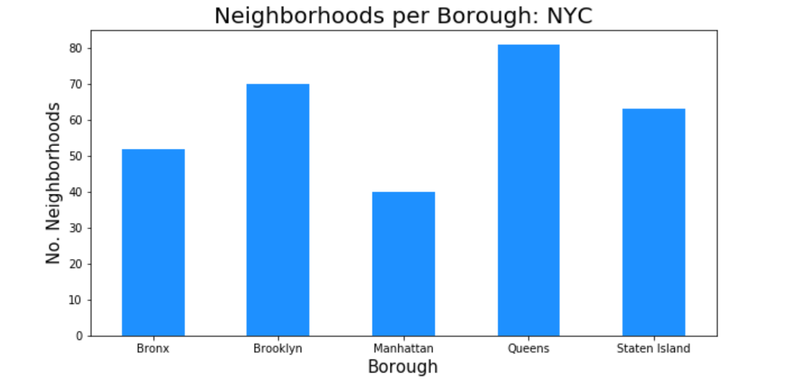
Organizing boroughs by neighborhood density.

Slide 5
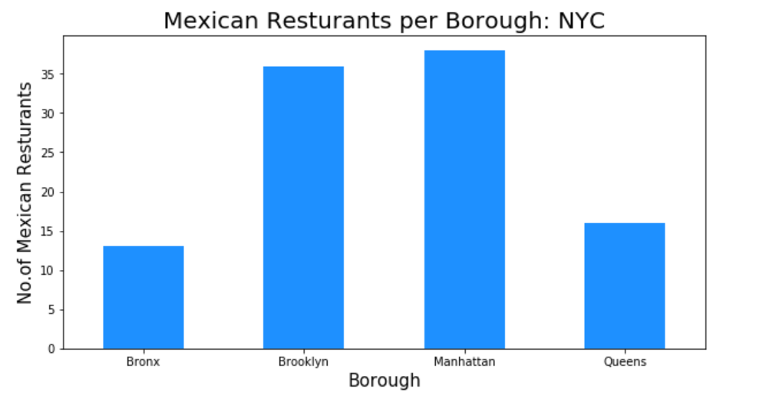
Organiznig the data in Mexican Venues per Borough

Slide 6
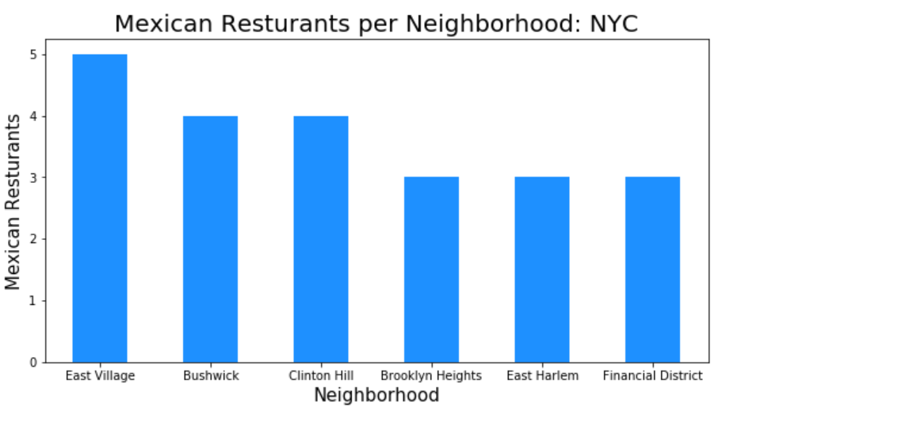
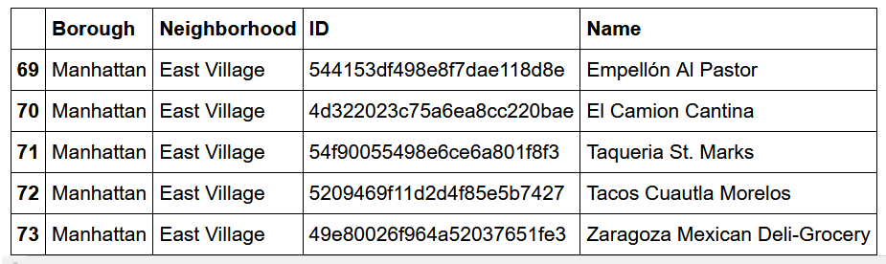
Mexican venues then refined to per neighborhood

Slide 7
Rankings, likes and tips
To get a better idea of the quality of venues, Rankings, likes and tips were used as factors to further refine and filter the data using the same method, borough first then neighborhood.

Slide 8
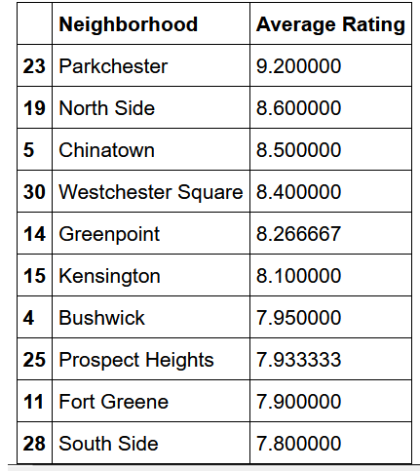
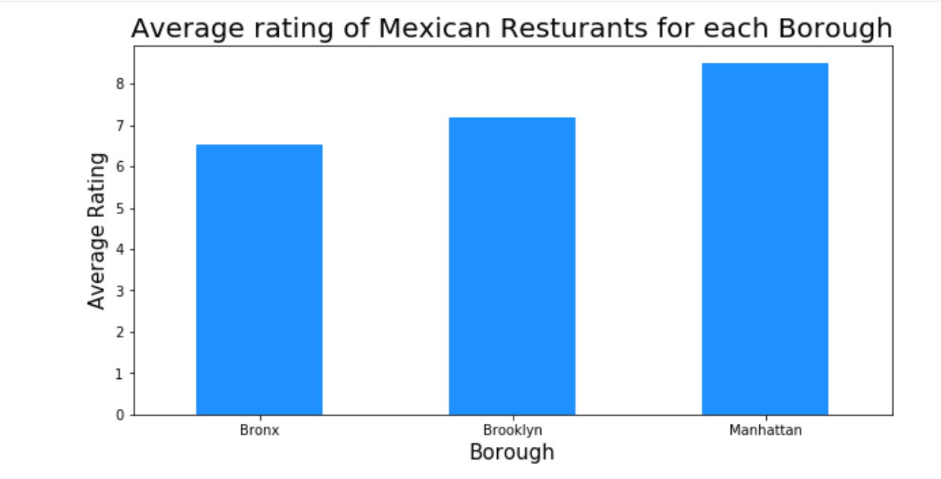
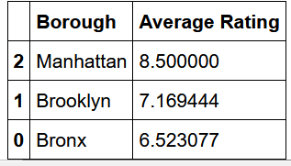
Visualization of results

Slide 9
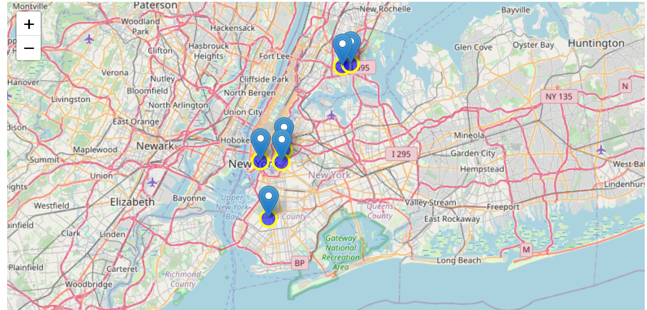
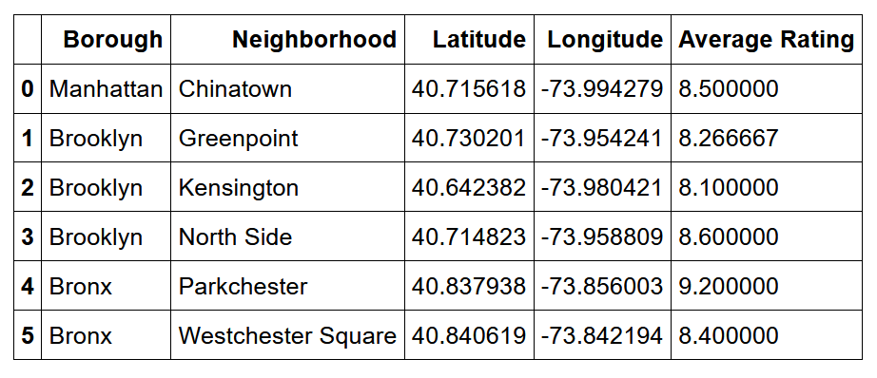
Final ranking and map
The data was then organized by average rating within a radius of 1000 meters and placed on a map.

Slide 10
conclusion
The Data frame reveals that Manhattan has the most available Mexican Venues, with the highest rated in its neighborhood of Chinatown. Brooklyn and the Bronx are second and third respectively in frequency yet are tied for first in quality. These two boroughs hold more higher rated and liked restaurants than Manhattan. So for travelers the data recommends that to enjoy quality Mexican cuisine, Brooklyn and Manhattan are the Boroughs with Chinatown, Greenpoint and Kensington as the highest rated neighborhoods.

